Slide 1
Project 7: Parking Spaces Occupancy Prediction
Zoe Hite, Brian Aguilar, Tejas Shetty, Atul Balaji, Vihaan Ambre
CS4624: Multimedia & Hypertext Capstone

Slide 2
Outline
Problem | Breaking down the why of our project
Solution | Explaining our end goal
Motivation | Discussing how impactful this project can be
Deliverables | Requirements of the project
System Architecture | The frameworks and development tools we will use
Timeline/Milestones | Our current plan for the future
Acknowledgements/ References | Resources used for this project

Slide 3
Problem
Currently, Virginia Tech’s parking lot situation leads to the following:
Parking scarcity leads to drivers wasting considerable time
Drivers may make uninformed decisions based on static parking availability information
No real-time updates for parking lot availability
Our project aims to improve upon these key points

Slide 4
Solution
Smart Parking System
Historical Data Analysis
Proposing a system that predicts parking occupancy using ML techniques
System will analyze historical data to predict parking availability more effectively

Slide 5
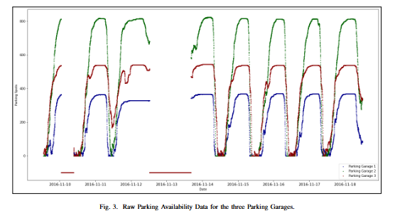
Example of Past Parking Data

Slide 6
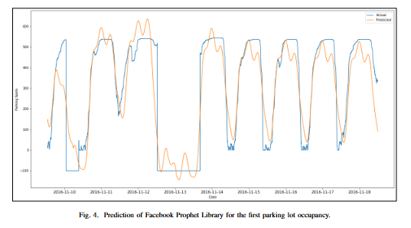
Example of Parking Lot Prediction

Slide 7
Obtaining the Parking Data
Currently in talks with a representative from VT parking services to possibly obtain live data from the 2-3 main parking garages.
If we can get access and train our model on this data, it would make the app more dynamic and provide actual value to VT students.

Slide 8
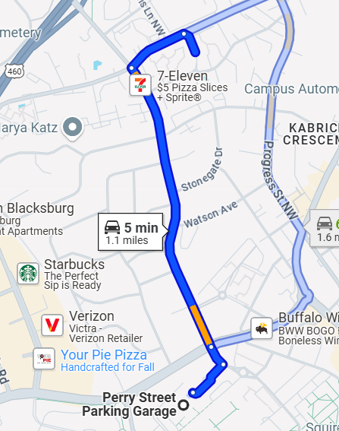
Motivation
Using real data from Virginia Tech parking garages
Having a real impact in the Virginia Tech community
UX/UI design to reflect Blacksburg area
Predict from residential areas, primarily useful for VT students

Slide 9
Deliverables
Machine Learning Model
Time Series Graph with time series casting
Decision making made on:
Nearest parking garage
Shortest distance
Garage with the most parking spots
User Application
UI centered around Virginia Tech, regardless of data source
Human Computer Interaction (HCI)-focused approach
Prediction Algorithm to recommend ideal parking garage based on user ranked criteria (distance, # of open spots, etc.)

Slide 10
Roles/Responsibilities
Team Lead/Report Writing: Vihaan Ambre
Lead Frontend: Brian Aguilar
Lead Design/Backend: Tejas Shetty
Lead Machine Learning: Zoe Hite
Backend/Frontend Support: Atul Balaji

Slide 11





System Architecture
Python
Flask
To create and train the ML Model using:
Pandas
TensorFlow
Numpy
Framework for Python and can easily build APIs
MySQL
React
Chosen for its scalability and high performance
Easy to use and will ensure an efficient and responsive UI
Notes:
The paper mentions using Artificial Neural Networks (ANNs) and Recurrent Neural Networks (RNNs).

Slide 12
Current Timeline
1/28 - 2/3
2/4 - 2/10
2/11-2/18
2/19- 3/5
3/6-3/17
3/18-4/5
Milestone 1
Milestone 2
Milestone 3
Milestone 4
Milestone 5
Milestone 6
Review the Project Launch page, schedule an appointment with the Client, delegate tasks, and appoint a team leader
Identify potential datasets (contact Virginia Tech Parking Services), meet with client, establish novelties
Research previous projects, summarize findings, display information on project presentation, finalize timeline
Finalize dataset selection,
Begin initial ML model development (data preprocessing, feature selection)
Train a baseline ML model, evaluate initial results & refine approach
Develop REST API to interact with the ML model, test API with sample requests, set up and integrate database for parking data storage
.

Slide 13
Current Timeline Cont.
4/6 - 4/10
4/11 - 4/17
4/18 - 4/24
4/25 - 5/2
Milestone 7
Milestone 8
Milestone 9
Milestone 10
Develop UI wireframes/mockups,
build a working prototype with dummy data
Connect ML model, API, database, and frontend
Conduct unit and integration testing
Optimize model performance and database queries
Finalize user & developer manuals
Prepare final project demo

Slide 14

Acknowledgements
Client
Mohamed Farag
mmagdy@vt.edu
Instructor
Dr. Farag
mmagdy@vt.edu

Slide 15
References
James Jang, Nam Tran, Drew Loomis, Avi Mehta, Bowen Lin. (April 2023). Smart Parking Recommender Mobile Application. Report. Retrieved from Virginia Tech VTechWorks.
https://vtechworks.lib.vt.edu/items/3ad329e0-be66-4b62-b1d0-29646f88ba1f
Mohamed Farag, Josh Marcelin, Adi Hanumaiah, Antonio Lau, Kevin He, Eugene Kwon. (November 2023). Parking Spaces Occupancy Prediction. Report. Retrieved from Virginia Tech VTechWorks.
https://vtechworks.lib.vt.edu/items/d313d723-23ad-441d-9662-3bcc8cbed52c
Mohamed Farag, Amr Hilal, Samy El-Tawab. Parking Occupancy Prediction and Traffic Assignment in a University Environment. Report. Retrieved from professor.

